Slide 1

Microfinance in the
Rana, Kohsuke, Jackie

Slide 2
Agenda
What is Microfinance
Facts about Philippines
Sample data set background information
Regression: OSS and PAR
Time series analysis
Simple moving average

Slide 3
What is Microfinance
Known as microcredit, microlending, microloan
Lending of small amounts of money at low interest to new businesses in the developing world.
It is believed that the system started in Bangladesh in 1976, when an economics professor loaned a group of women $27 to finance their own small business. Amazingly the women repaid the loan and were able to sustain the business.

Slide 4
Facts of The Philippines
Total Population = 101 Million
GDP per Capita = $2,899 (SE Asia Rank: 6th of 11 countries, Worldwide Rank: 148th)
Life Expectancy at Birth = 68 years
Unemployment Rate = 7.1%
Adult Literacy Rate = 95.42%
Capital and Largest City = Manila

Slide 5
Data Set Background Information
Sample data from 2010-2018
41 MFI self reporting to mixmarket
Type of MFI: Banks, Rural Banks, Non-Government Organizations, Credit Union
Notes:
Not representative

Slide 6
Definition of OSS
Operational Self Sufficiency
How successful MFI is
OSS provides an indication as to whether a Microfinance Institution (MFI) is earning sufficient revenue (through interest, fee, and commission income) so as to cover its total costs-financial costs, operational costs and loan loss provisions.
Notes:
R

Slide 7
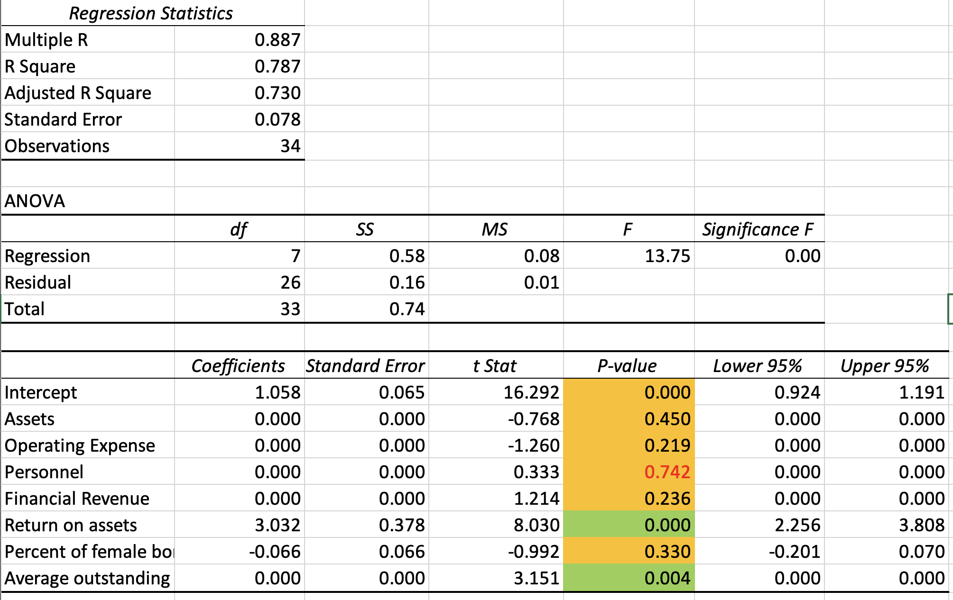
OSS Regression Analysis Beginning
Notes:
Gonna be with R

Slide 8
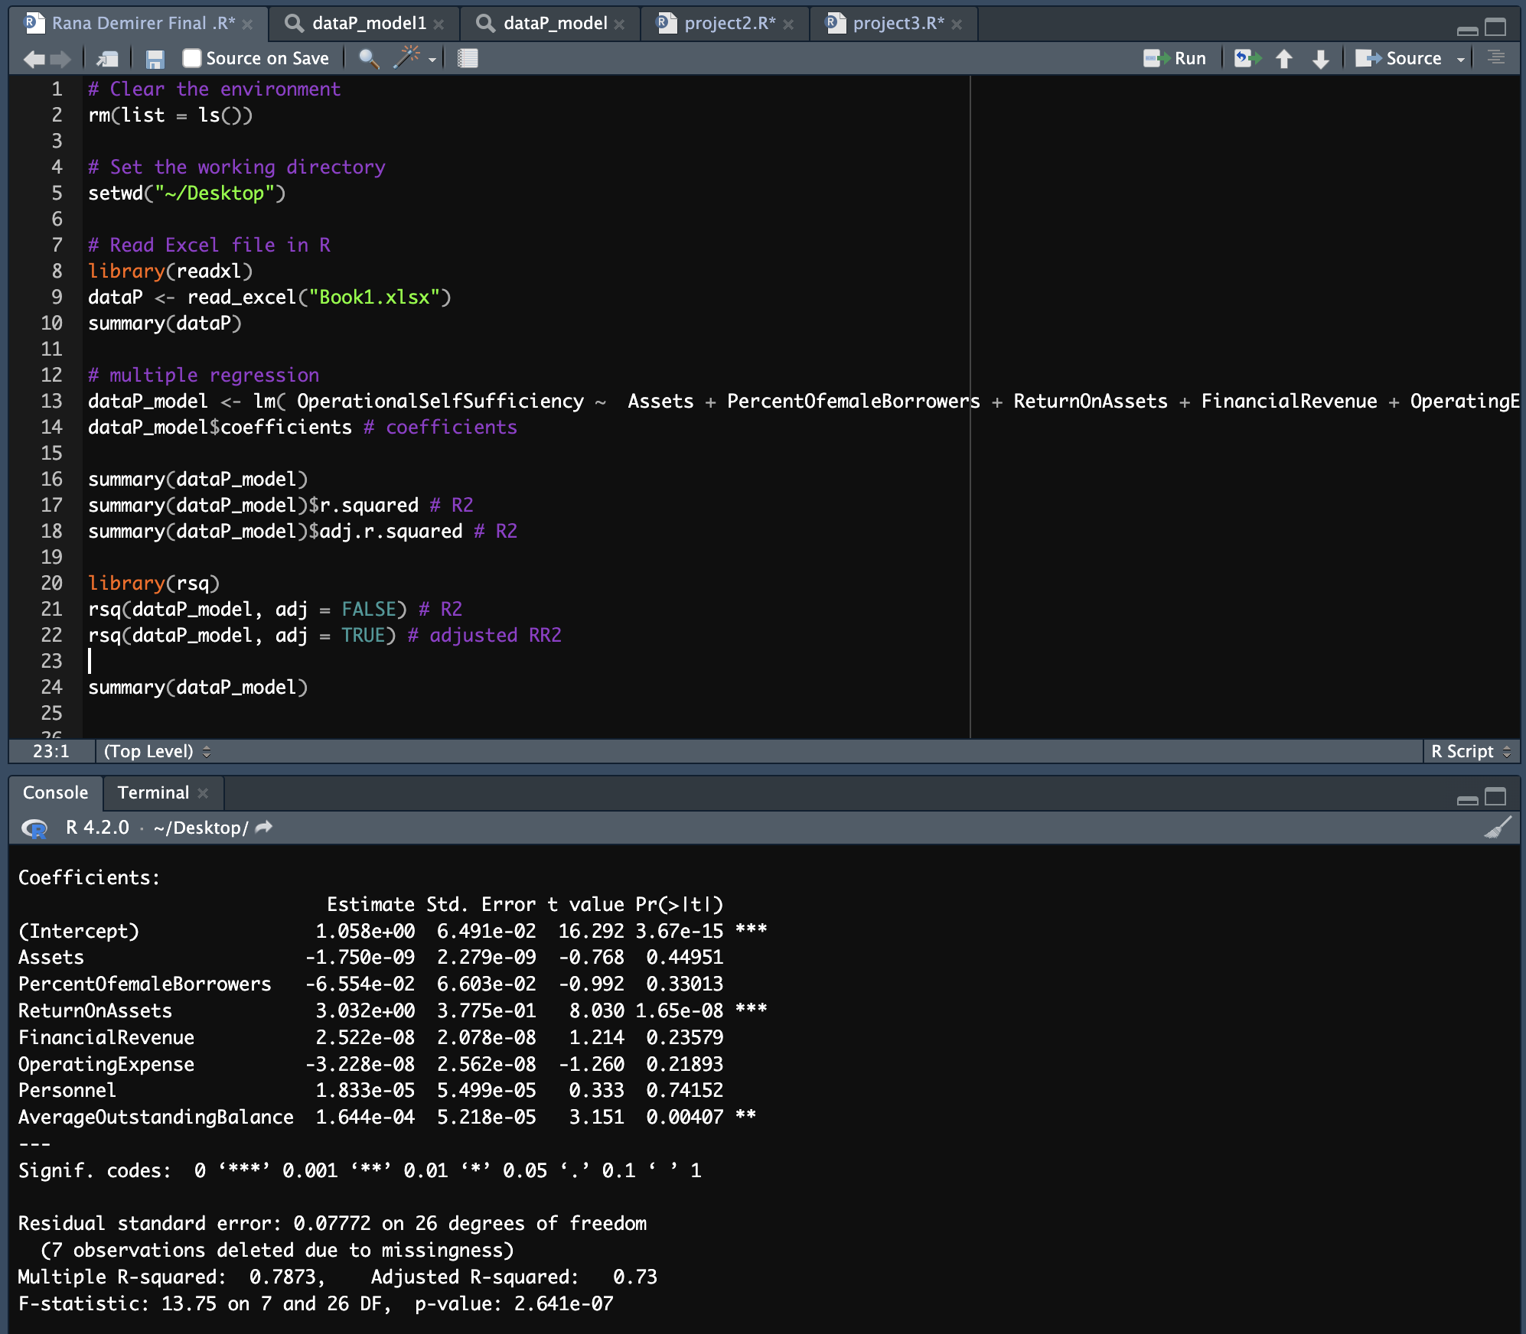

Slide 9
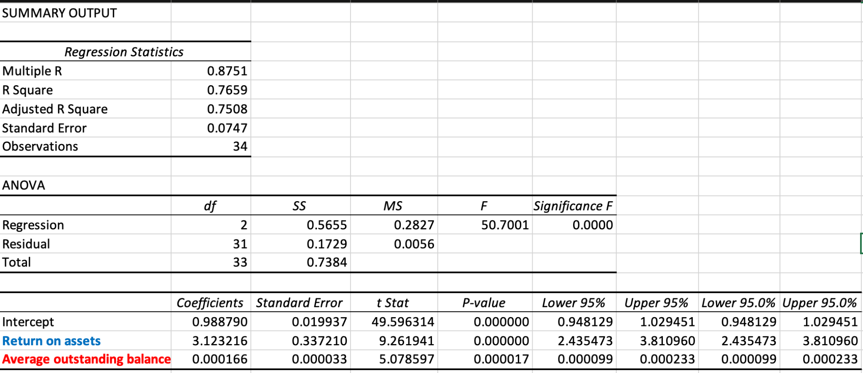
OSS Regression Final Result

Slide 10
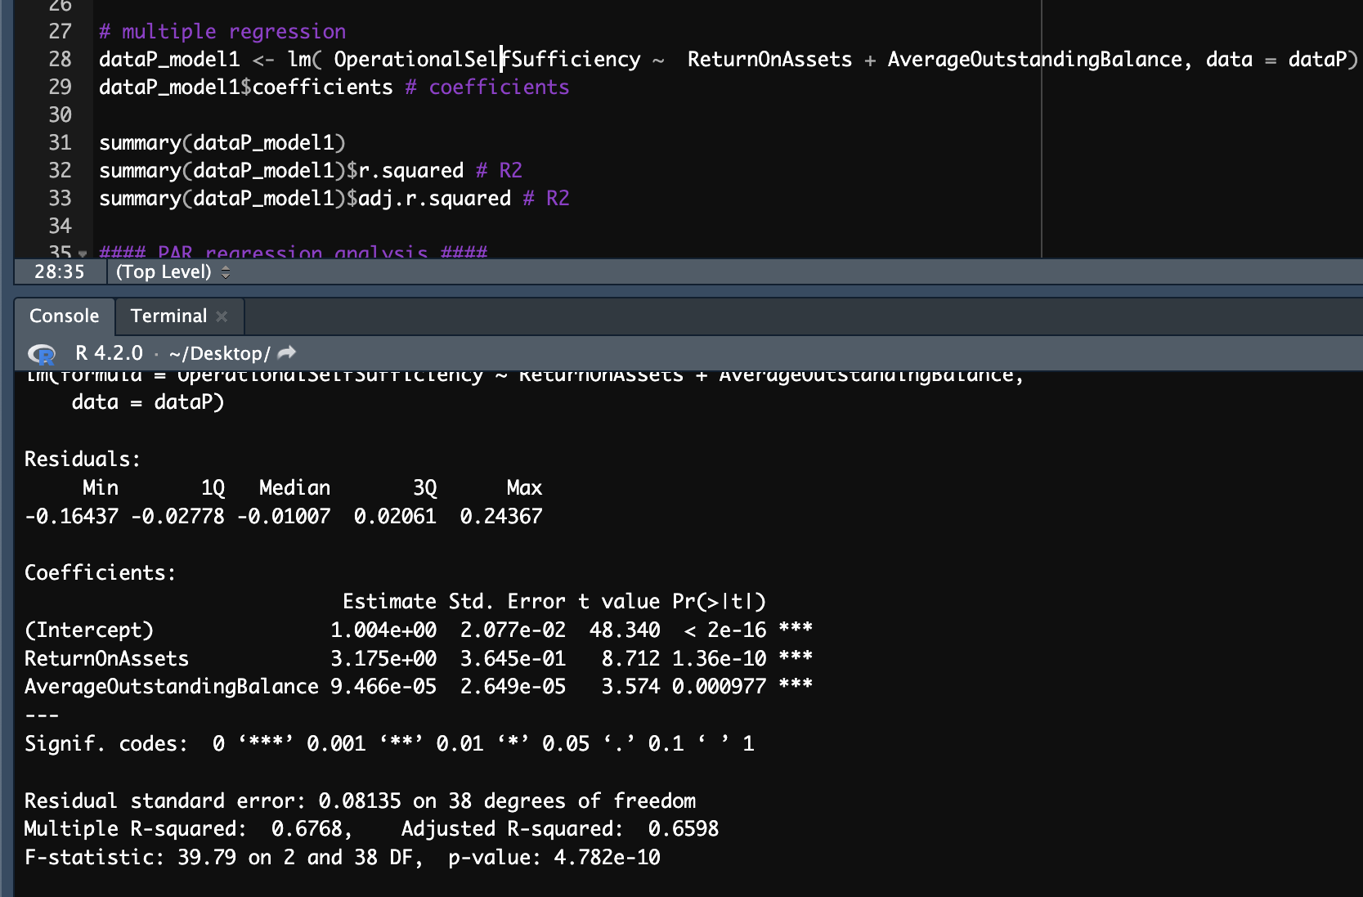

Slide 11
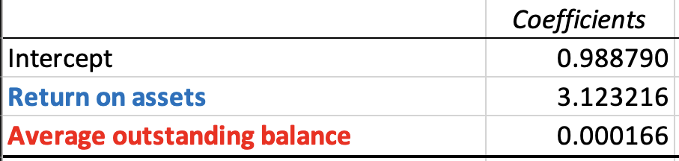
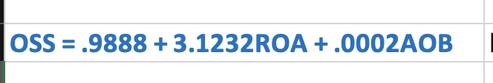
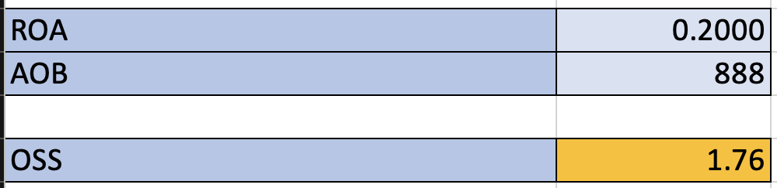
OSS Equation and Example
Example

Slide 12
Definition of PAR
Portfolio at Risk
Indicates the likelihood of defaulting on the loan, not pay on time
Greater than 30 days to pay back

Slide 13
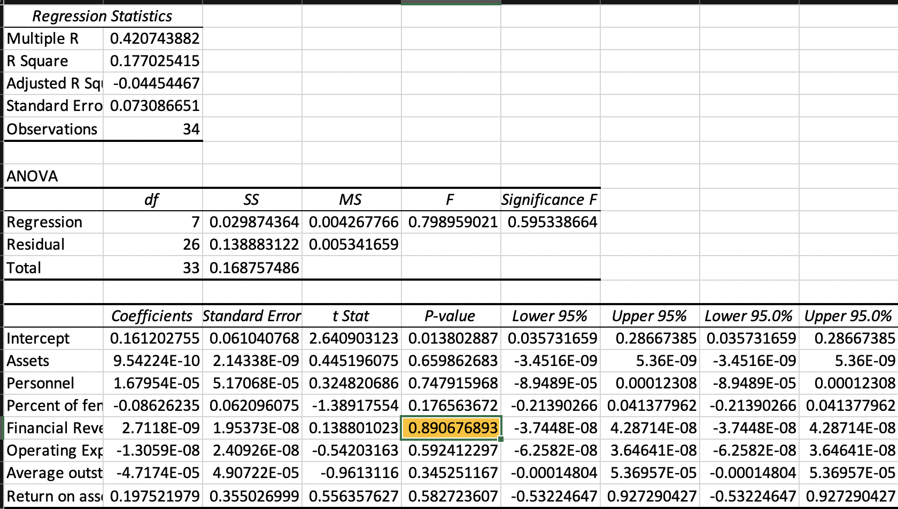
PAR Regression 𝞪 = .05
Show first and last one
Talk about final result
Equation, what means
Show how equation is used

Slide 14
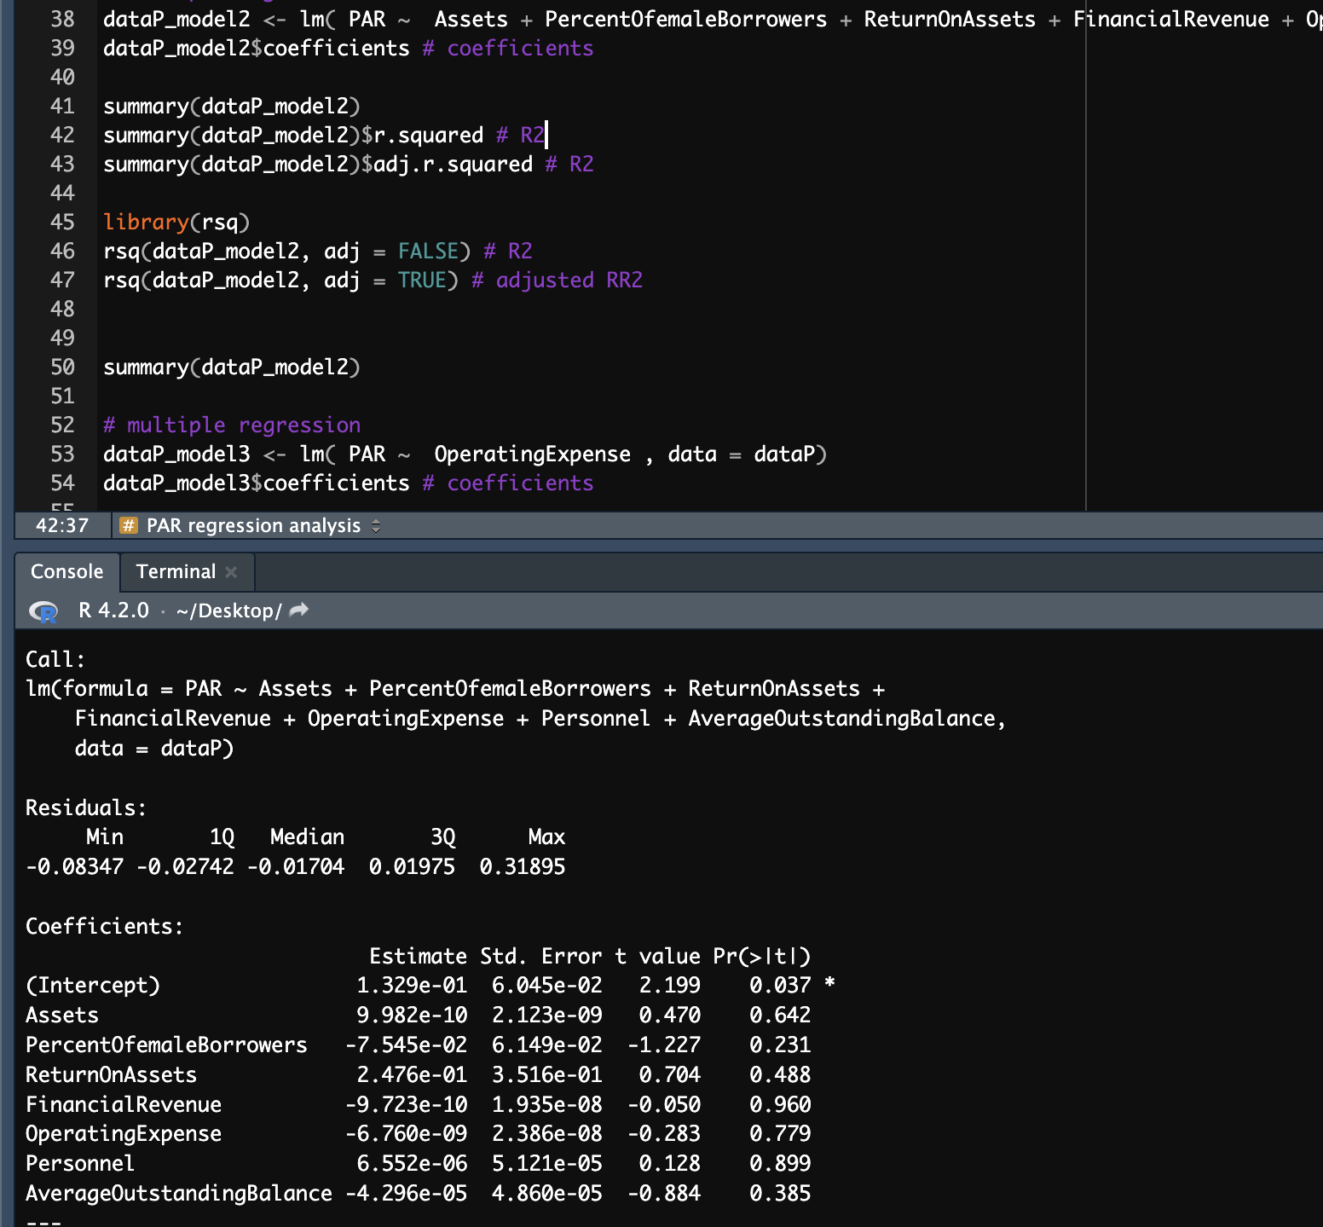

Slide 15
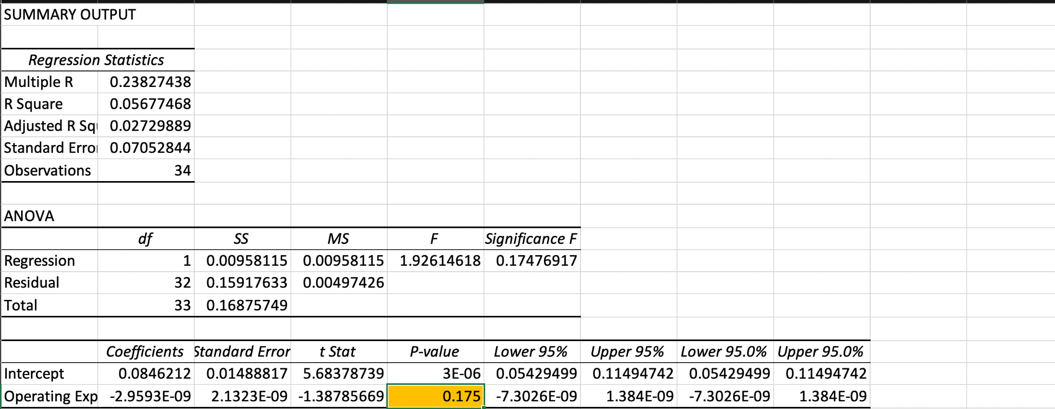
PAR Regression 𝞪 = .05
All variables are rejected.
There is no relationship between these variables.

Slide 16
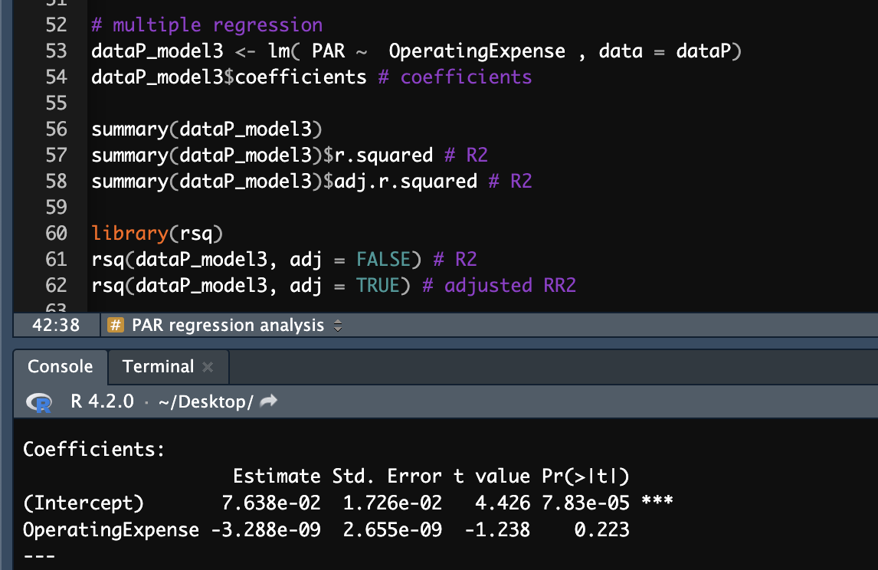

Slide 17
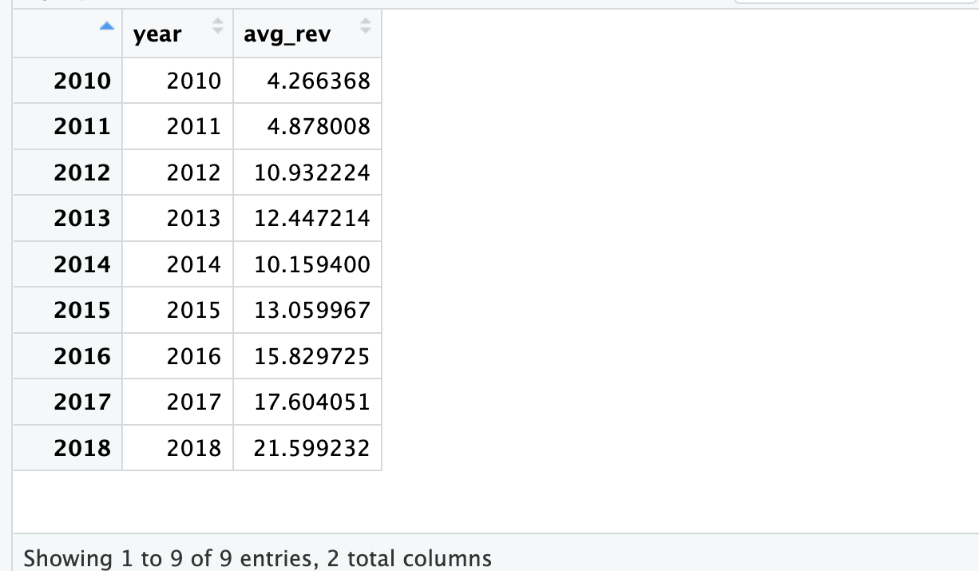
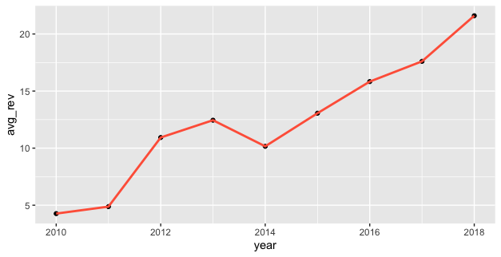
Time series analysis(2010 ~2018)
Dataset from mixmarket.org
From data of 2010 ~ 2018,
Forecast average financial revenue
in 2019.

Slide 18
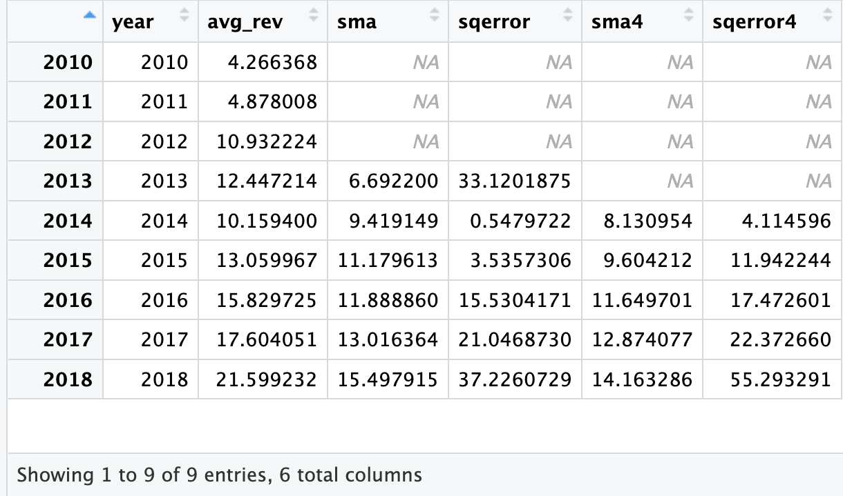
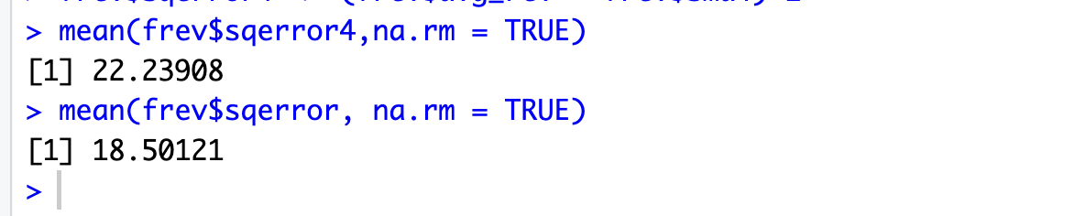
SMA(financial revenue)
sma (3 simple moving average)
sma4 (4 simple moving average)
3 moving avg is better.

Slide 19
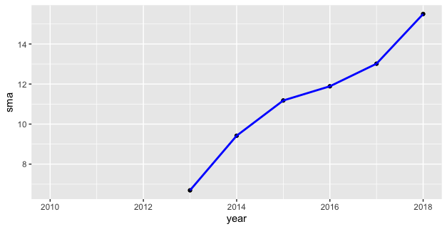
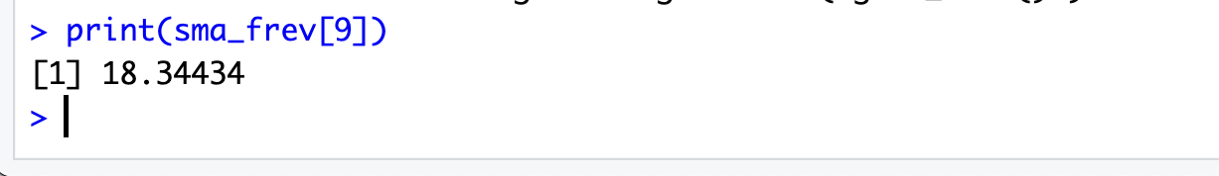
Forecasted avg financial revenue in 2019:
18.34434(million)

Slide 20
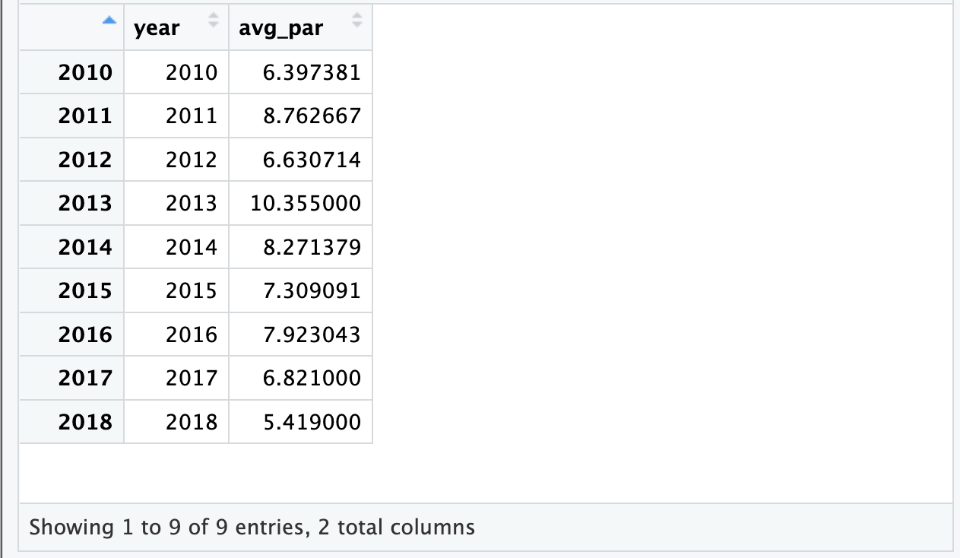
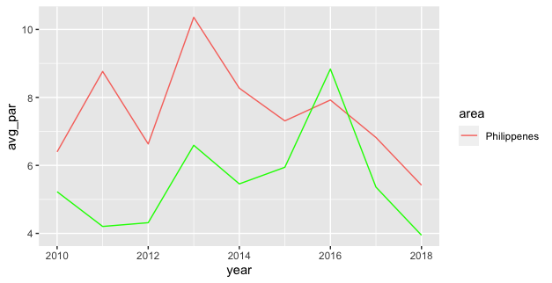
SMA(PAR)
Dataset from mixmarket.org
From data of 2010 ~ 2018,
Forecast average PAR in 2019.

Slide 21
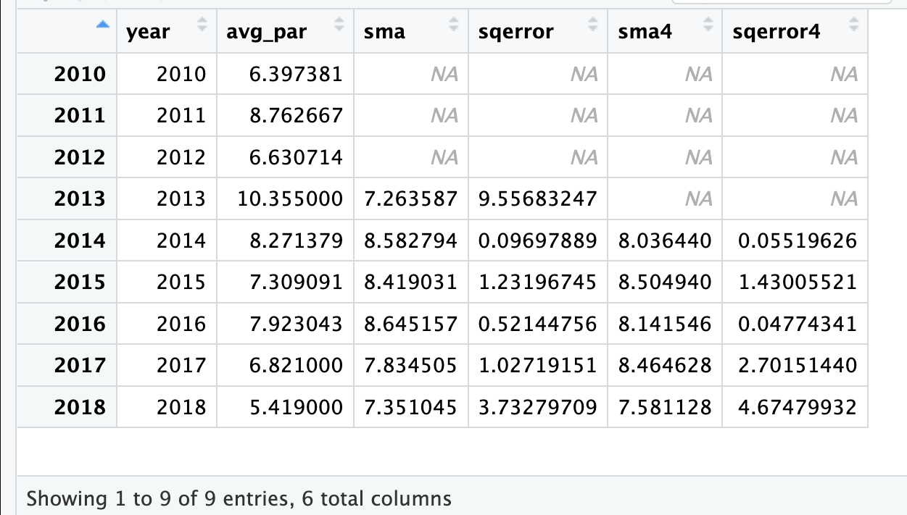
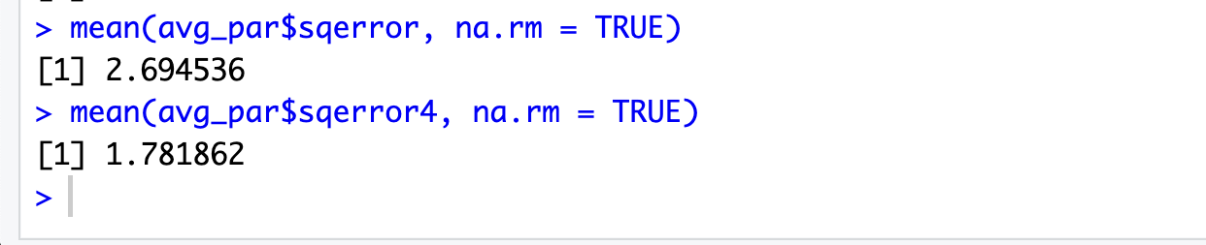
SMA(PAR)
sma (3 simple moving average)
sma4 (4 simple moving average)
4 moving avg is better.

Slide 22
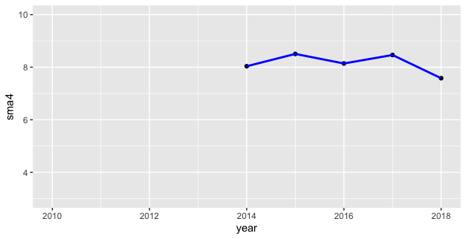
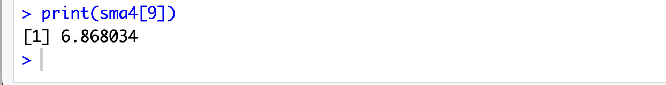
Forecasted avg financial revenue in 2019:
6.868034 %

Slide 23
Conclusions
Regression analysis helped us to examine the relationship between variables in a more detailed way after correlation analysis.
In conclusion, when ROA and Average Outstanding Balance is greater, OSS is greater.
Time series analysis found financial revenue increase while constant PAR.
Forecasted financial revenue and PAR in 2019 is about 18 million and 7%.
Microfinance in Philippines perform well.

Slide 24
References
Bory (2020) Operational self sufficiency: Definition: Example, Accountinguide. Available at: https://accountinguide.com/operational-self-sufficiency/ (Accessed: February 24, 2023).
Hayes, A. (2023) Simple moving average (SMA): What it is and the formula, Investopedia. Investopedia. Available at: https://www.investopedia.com/terms/s/sma.asp (Accessed: February 24, 2023).
Kagan, J. (2023) Microfinance definition: Benefits, history, and how it works, Investopedia. Investopedia. Available at: https://www.investopedia.com/terms/m/microfinance.asp (Accessed: February 24, 2023).
Mix market (no date) DataBank. Available at: https://databank.worldbank.org/source/mix-market (Accessed: February 24, 2023).

